Slide 1

React
Lifecycle
Sangeeth Sudhakaran

Slide 2
Introduction
We have seen so far that React web apps are a collection of independent components that run according to the interactions made with them.
Every React Component has a lifecycle of its own, lifecycle of a component can be defined as the series of methods that are invoked in different stages of the component’s existence.
These built-in lifecycle methods which maintains or controls the behavior of components within an application.
2

Slide 3
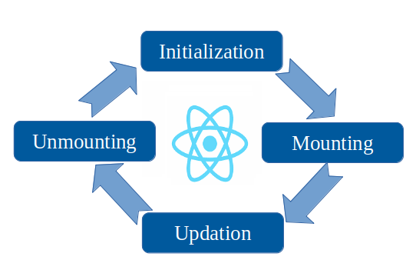
Lifecycle
3

Slide 4
Lifecycle of Components
Each component in React has a lifecycle which you can monitor and manipulate during its four main phases.
The four phases are:
Initialization
Mounting – component born
Updating – component grows
Unmounting - component dies
4

Slide 5
Initialization This is the stage where the component is constructed with the given Props and default state. This is done in the constructor of a Component Class.
Mounting Mounting is the stage of rendering the JSX returned by the render method.
Updating Updating is the stage when the state of a component is updated, and the application is repainted.
Unmounting As the name suggests Unmounting is the final step of the component lifecycle where the component is removed from the page.
React provides the developers a set of predefined functions that if present is invoked around specific
events in the lifetime of the component. Developers are supposed to override the functions with desired logic to execute accordingly. We have illustrated the gist in the following diagram.
5

Slide 6
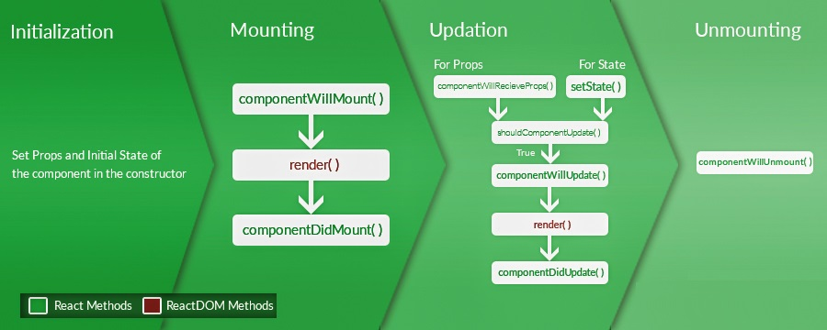
6

Slide 7
1. Initial Phase
It is the start phase of the lifecycle of a ReactJS component towards the DOM. In this phase, a component contains the default Props and initial State. These default properties are done in the constructor of a component. The initial phase only occurs once and consists of the following methods.
The constructor() method is called before anything else, when the component is initiated, and it is the natural place to set up the initial state and other initial values.
getDefaultProps()
It is used to specify the default value of this.props. It is invoked before the creation of the component or any props from the parent is passed into it.
getInitialState()
It is used to specify the default value of this.state. It is invoked before the creation of the component.
7

Slide 8
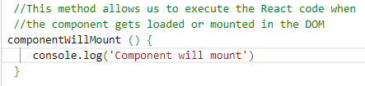
2. Mounting Phase
In this phase, the instance of a component is created and inserted into the DOM. It consists of the following methods.
componentWillMount()
This is invoked immediately before a component gets rendered into the DOM. In the case, when you call
setState() inside this method, the component will not re-render.
8

Slide 9


componentDidMount()
This is invoked immediately after a component gets rendered and placed on the DOM. Now, you can
do any DOM querying operations.
render()
This method is defined in each and every component. It is responsible for returning a single root HTML node element. If you don't want to render anything, you can return a null or false value.
9

Slide 10

3. Updating Phase
In this phase we get new Props and change State, and also allows to handle user interaction and provide communication with the components hierarchy. The main aim of this phase is to ensure that the component is displaying the latest version of itself. Unlike the other phases this phase repeats again and again. This phase consists of the following methods
componentWillRecieveProps()
It is invoked when a component receives new props. If you want to update the state in response to prop changes, you should compare this. props and nextProps to perform state transition by using this.setState() method.
10

Slide 11
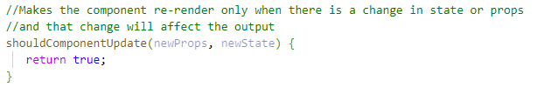
shouldComponentUpdate()
It is invoked when a component decides any changes/updation to the DOM. It allows you to control the component's behavior of updating itself. If this method returns true, the component will update. Otherwise, the component will skip the updating.
11

Slide 12

componentWillUpdate()
It is invoked just before the component updating occurs. Here, you can't change the component state by invoking this.setState() method. It will not be called, if shouldComponentUpdate() returns false.
render()
It is invoked to examine this.props and this.state and return one of the following types: React elements, Arrays and fragments, Booleans or null, String and Number. If shouldComponentUpdate() returns false, the code inside render() will be invoked again to ensure that the component displays itself properly.
12

Slide 13

componentDidUpdate()
It is invoked immediately after the component updating occurs. In this method, you can put any code
inside this which you want to execute once the updating occurs. This method is not invoked for the initial render.
13

Slide 14

4. Unmounting Phase
It is the final phase of the react component lifecycle. It is called when a component instance is destroyed and unmounted from the DOM.
This phase contains only one method and is given below.
componentWillUnmount()
This method is invoked immediately before a component is destroyed and unmounted permanently.
It performs any necessary cleanup related task such as invalidating timers, event listener,
canceling network requests or cleaning up DOM elements. If a component instance is unmounted,
you cannot mount it again.
14

Slide 15
Conclusion
Lifecycle methods are an essential part of working in React. You should know that working with classes and understanding them gives you a significant advantage for building awesome applications.
15

Slide 16




Thank you

